Slide 1
PRIVATE SECURITY INDABA 2019
3 – 4 JULY 2019
Presentation by:
MR STEFAN BADENHORST

Slide 2
OVERVIEW OF THE PRIVATE SECURITY INDUSTRY

Slide 3
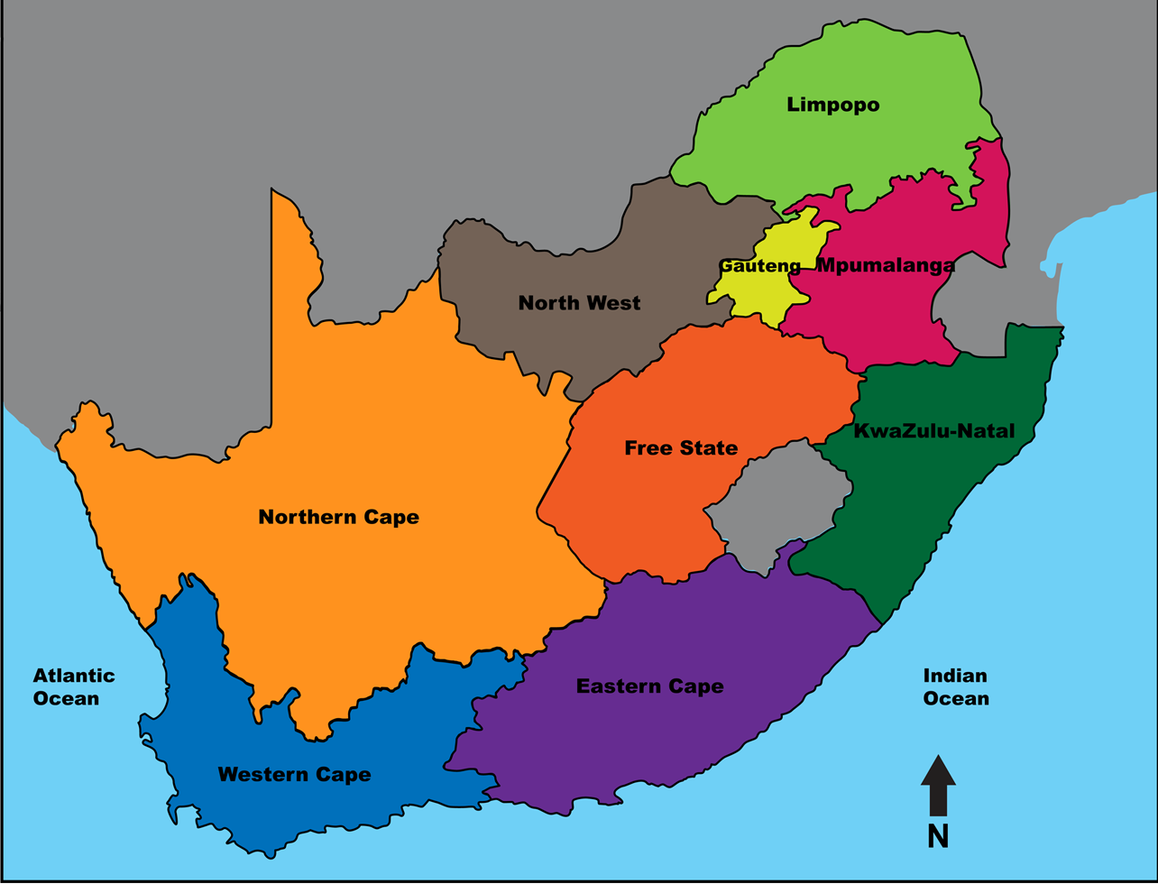
Programme 3: Key Highlights
GEOGRAPHIC SPREAD
REGISTERED ACTIVE SECURITY BUSINESSES & OFFICERS
Total Security Officers: 535 857
Total Businesses: 9 447
FINANCIAL HIGHLIGHTS FOR 2017/2018
44 639
834
199 159
3 847
29 874
366
39 205
585
17 876
241
5 658
140
93 455
1 660
44 482
731
61 509
1 403

Slide 4
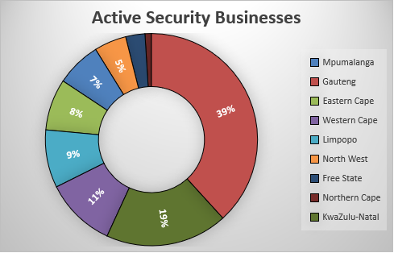
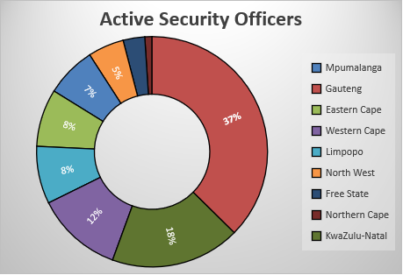
Programme 3: Key Highlights
Active Security Businesses & Security Officers

Slide 5
Programme 3: Key Highlights
COMPARISON OF ACTIVE BUSINESSES AND SECURITY OFFICERS OVER A PERIOD OF NINETEEN YEARS
FINANCIAL HIGHLIGHTS FOR 2017/2018

Slide 6
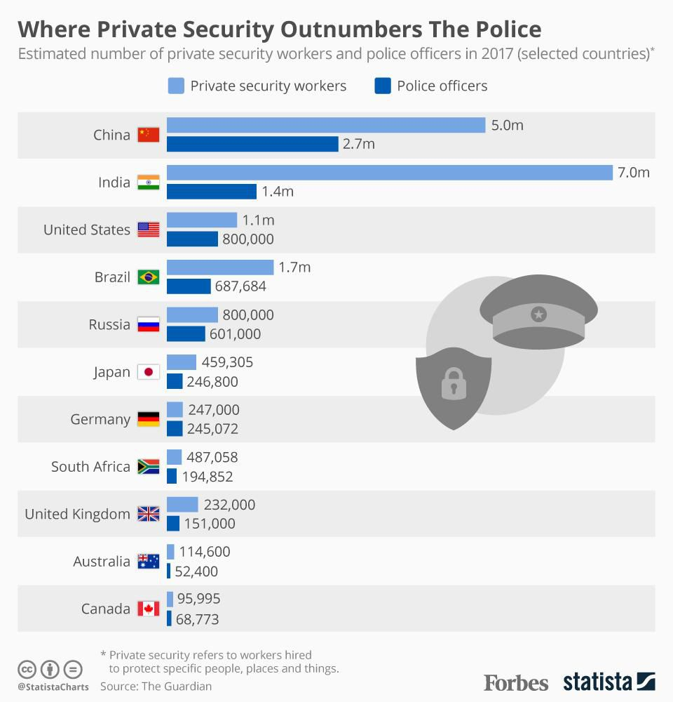
SA’s Private Security Industry- Forbes

Slide 7
Industry Categories
Guarding Sector
Response Security
Assets In transit
Events Security
Control Room
Close Protect-ion
Manufac-turers
Lock-smith
Electro-nic Security
Security Training
Private Investigators
Security Consul-tants
In-house
Security
Categories

Slide 8

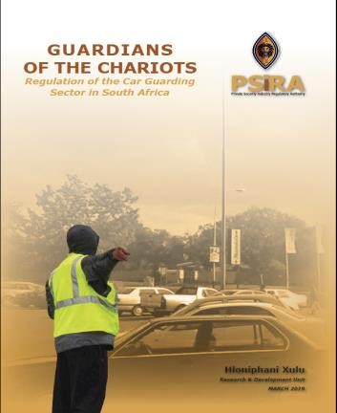

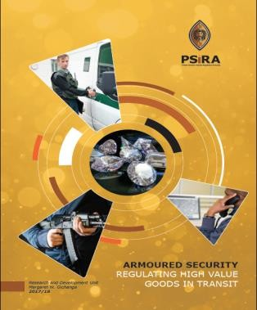


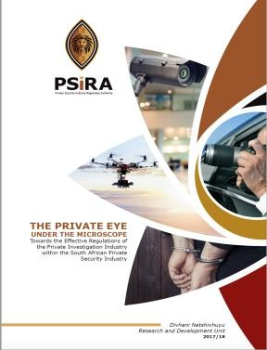



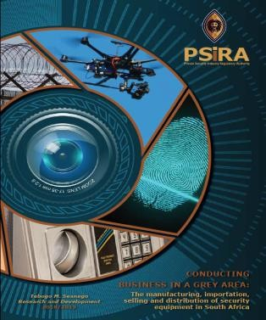
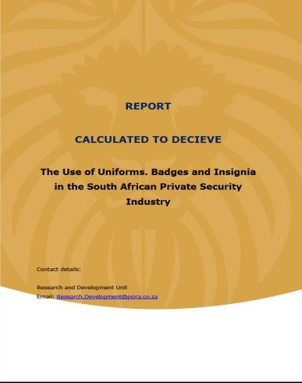
Research Projects
Crime Prevention
Car Watch
Dog Handling
Assets in Transit
Campus Security
Close Protection
Private Investigation
Training
Public Schools
Labour Brokers
Equipment
Uniforms, Badges & Insignia

Slide 9



Research Projects…(Cont’d)
Locksmiths
Firearms
Events Security
New Research Areas – 2019/20
Aviation & Airport Security
Inhouse Security and Rail environment
Anti-poaching
Impact of 4th Industrial Revolution
Security Consultants

Slide 10
THANK YOU
Call Centre No.: 086 10 PSiRA (77472)
Website: www.psira.co.za

